Slide 1
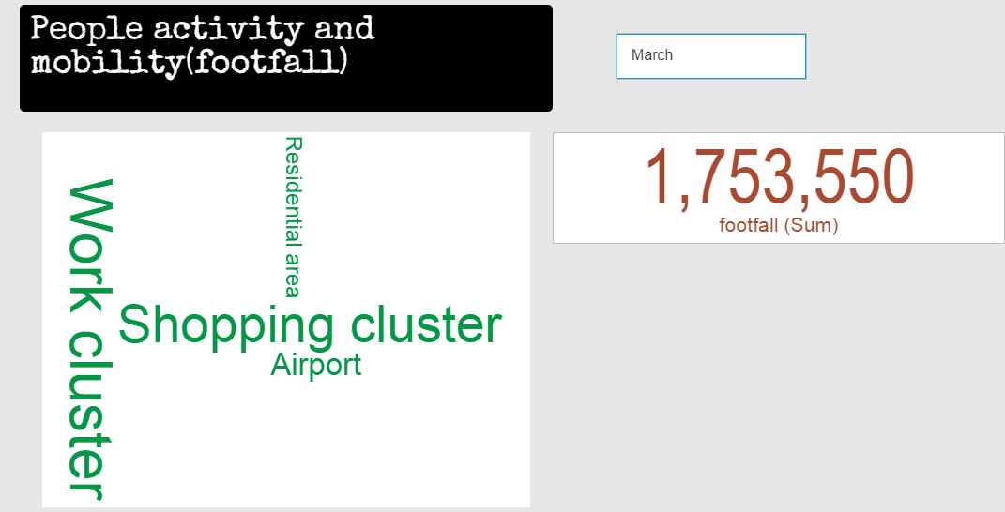
Siti Nurafifah bte Md Rusli

Slide 2
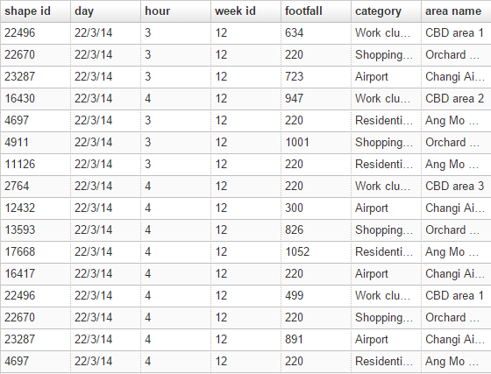
Dataset- Footfall count by hour by day of specific locations
Abstract:
Unique number people visited
specific location by hour by day.
Four types of locations were
selected: work cluster, airport,
shopping area and residential
areas.

Slide 3
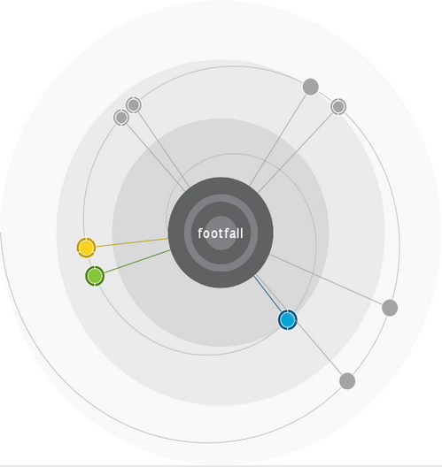
What influences footfall?
Area name and hour together are a
Predictor of Footfall.
67.9%
Predictive strength

Slide 4
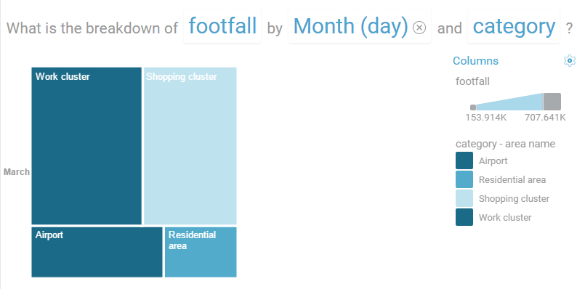
Popular
location

Slide 5
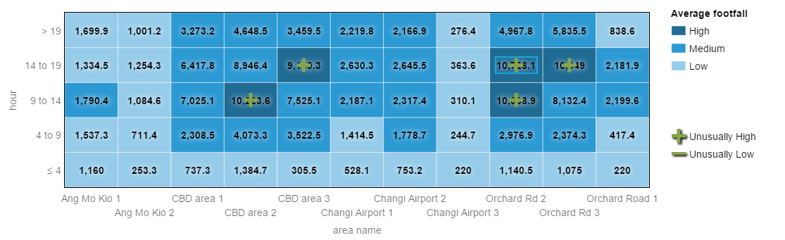
The interaction of area name and hour drives footfall
Each cell represents the footfall average at a combination of categories of
area name and hour

Slide 6
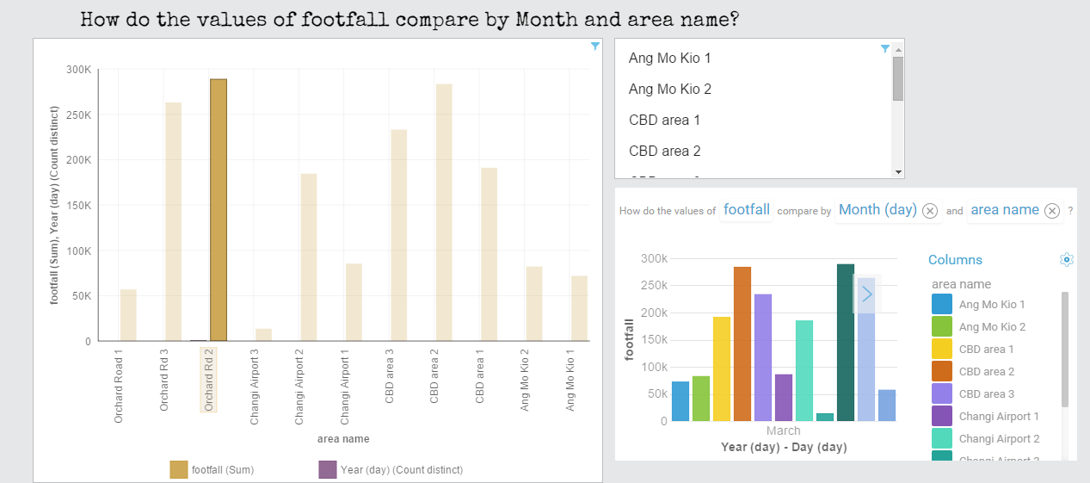

Slide 7
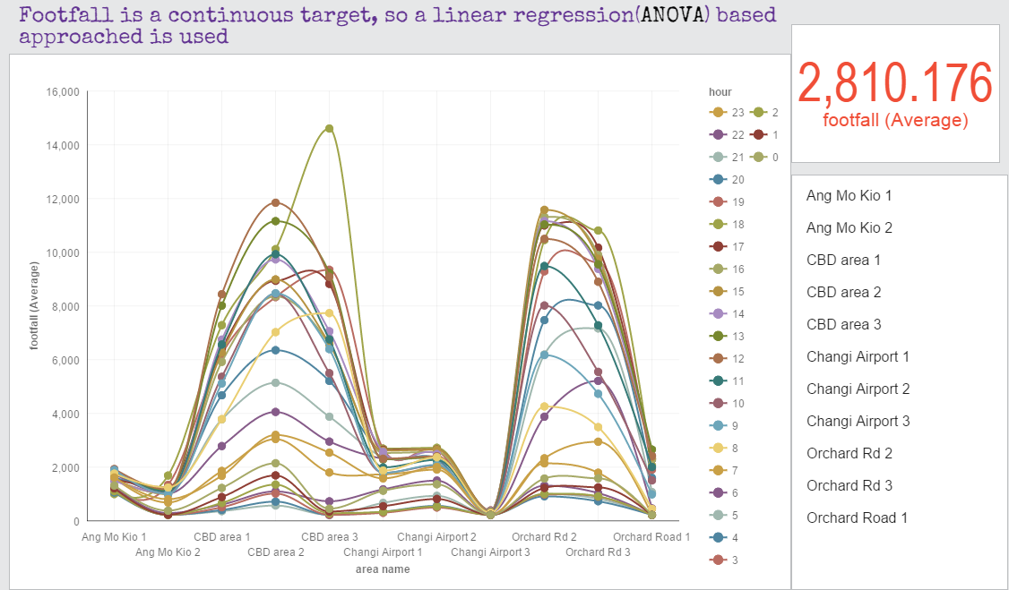

Slide 8
Question
Will it remain popular?

Slide 9
References
http://ec2-54-169-65-124.ap-southeast-1.compute.amazonaws.com/ckan/dataset/footfall-count-by-hour-by-day-by-loc
https://watson.analytics.ibmcloud.com/

